Slide 1
“Teach A Level Maths”
Statistics 1
The Binomial Distribution: Using Tables
© Christine Crisp

Slide 2
Statistics 1
AQA
MEI/OCR
OCR
"Certain images and/or photos on this presentation are the copyrighted property of JupiterImages and are being used with permission under license. These images and/or photos may not be copied or downloaded without permission from JupiterImages"

Slide 3


We do not always need to use the formula to find binomial probabilities.
Suppose X is a random variable with a binomial distribution, then
and is given in tables for some values of n and p.

Slide 4



Exercise
1. Find the table “Cumulative Binomial Distribution Function” in your formula booklet. The table is spread over several pages.
Find the heading on the 1st page of the table and notice that it contains a reminder that the numbers shown are for .
Find the section for n = 10 and look under the column for p = 0·3 to find
You get

Slide 5













Exercise
If ,
(a) find
(b) Use the answer to (a) to find .
(c) Find .
(d) Use the answers to (a) and (c) to find .
Solution:
(a)
(b)
(c)
(d)

Slide 6















Exercise
3. If , use tables to find
(a)
(b)
(c)
(d)
Solution:
(a)
(b)
(c)
(d)

Slide 7










SUMMARY
If X is a random variable with a binomial distribution,
then is given in “Cumulative Binomial Distribution Function Tables” for some values of n and p.
Using the Tables:
e.gs.
can be read directly.

Slide 8
Only those of you taking the AQA specification need the next (final) section.

Slide 9


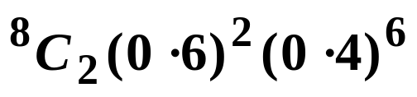

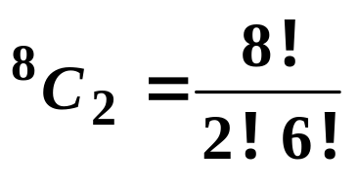
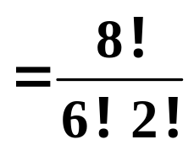
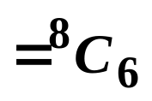
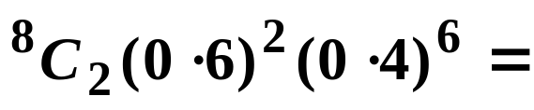
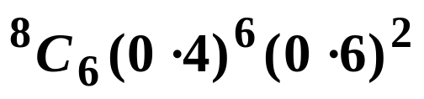
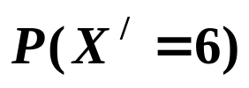


Your tables only show probabilities for values of p that are less than or equal to 0·5.
Suppose
X is the random variable with probability of success, p = 0·6 ( and failure 0·4 ).
We need to turn things around so that we can use the tables with p = 0·4. To see how to do this we’ll use
Using the formula,
However,
So,
and this is where

Slide 10
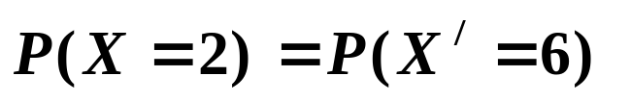

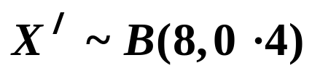


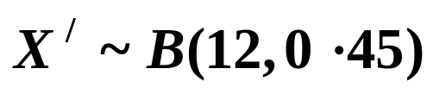
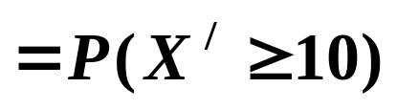
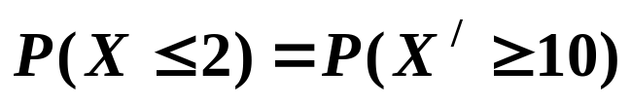
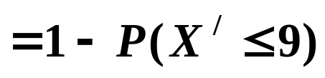


So,
where,
and
If we have a r.v. X with probability of success, p, we define X/ as the r.v. with probability of success 1 − p.
( The failures for X become the successes for X/ .)
e.g.1 Use tables to find if
So,

Slide 11

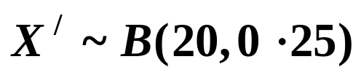
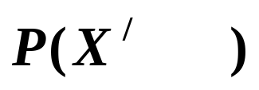




e.g.2 In a computer chip manufacturing process 75% of the output is acceptable. If a random sample of 20 is selected, what is the probability that at least 12 are acceptable?
Solution:
Let X be the r.v. “ the number acceptable”
Then,
Let X/ be the r.v. “ the number rejected” then
So,
This is 20 – 12, so in general it will be n − x

Slide 12
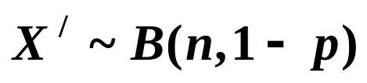

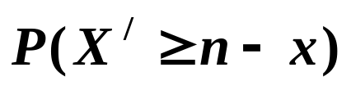

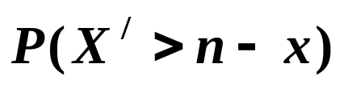

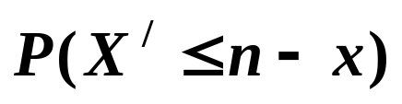

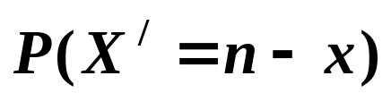
SUMMARY
To use tables when and p > 0·5, we
define a new r.v. X/ where .
change the probabilities so we are finding failures instead of successes, so, for example
In every case, x becomes n – x and any inequalities change around.

Slide 13






Exercise
1. If find .
2. If use tables to find . Check your answer using the formula.
3. If find
4. In a large consignment of daffodil bulbs, 80% are common varieties. What is the probability that in a bag of 20 bulbs no more than 15 are common varieties?

Slide 14

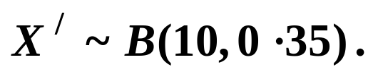
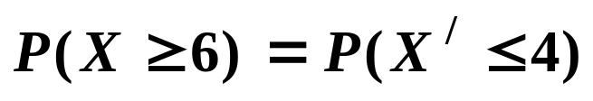


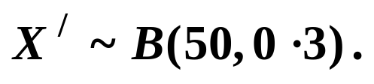
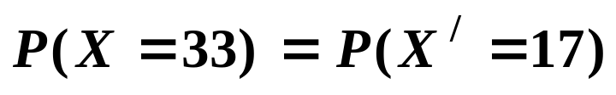
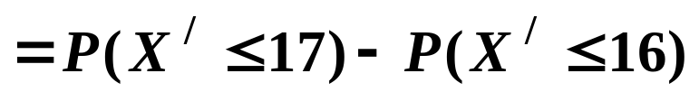


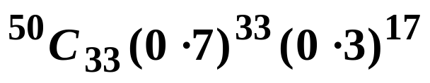


1. If find .
Solution:
Let
2. If (a) use tables to find . (b) Check your answer using the formula.
Solution:
Let

Slide 15

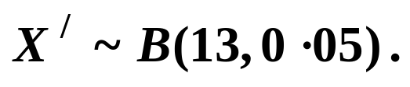
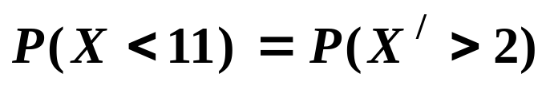
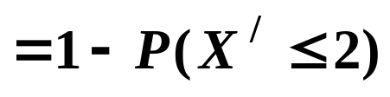



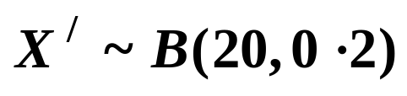
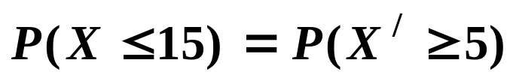
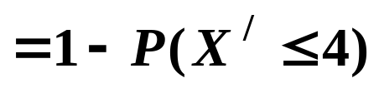


3. If find
Solution:
Let
4. In a large consignment of daffodil bulbs, 80% are common varieties. What is the probability that in a bag of 20 bulbs no more than 15 are common varieties?
Solution:
Let X be the r.v. “number of common bulbs“
Let

Slide 16


Slide 17
The following slides contain repeats of information on earlier slides, shown without colour, so that they can be printed and photocopied.
For most purposes the slides can be printed as “Handouts” with up to 6 slides per sheet.

Slide 18
SUMMARY
If X is a random variable with a binomial distribution,
then is given in “Cumulative Binomial Distribution Function Tables” for some values of n and p.
Using the Tables:
e.gs.
can be read directly.

Slide 19
e.g. If , use tables to find
(a)
(b)
(c)
(d)
Solution:
(a)
(b)
(c)
(d)

Slide 20
Only those of you taking the AQA specification need this section.
Your tables only show probabilities for values of p that are less than or equal to 0·5.
Suppose
X is the random variable with probability of success, p = 0·6 ( and failure 0·4 ).
We need turn things round so that we can use the tables with p = 0·4.

Slide 21


If we have a r.v. X with probability of success, p, we define X/ as the r.v. with probability of success 1 − p.
( X/ is the variable with Xs failures as its successes ).
e.g.1 Use tables to find if
where

Slide 22
e.g.2 In a computer chip manufacturing process 75% of the output is acceptable. If a random sample of 20 is selected, what is the probability that at least 12 are acceptable?
Solution:
Let X be the r.v. “ the number acceptable”
Then,
Let X/ be the r.v. “ the number rejected” then
So,
This is 20 – 12, so in general it will be n − x

Slide 23
SUMMARY
To use tables when and p > 0·5, we
define a new r.v. X/ where .
change the probabilities so we are finding failures instead of successes, so, for example
In every case, x becomes n – x and any inequalities change round.

